Slide 1

Inventory Management System
Transforming inventory control through sophisticated backend architecture that powers real-time operations and drives business efficiency.
Group 13

Slide 2

Why Inventory Management System Matter
Global Supply Chains
Elimination of Manual Errors
Modern businesses require real-time, accurate stock control across multiple locations to avoid costly overstock situations or devastating stockouts that impact customer satisfaction.
Spreadsheet-based methods and manual tracking lead to human errors, operational delays, and lost sales opportunities that can cripple business growth.
Automation & Integration
Modern backend systems enable seamless automation, infinite scalability, and smooth integration across warehouses, sales channels, and business systems.

Slide 3
Core Functional Requirements of the Backend
Product Management
Inventory Control
SKU tracking and organization
Real-time stock level tracking
Detailed product descriptions
Multi-warehouse support capabilities
Category classification systems
Automated threshold alerts
Product lifecycle status monitoring
Movement history tracking
Order Processing
Supplier Management
Reporting & Audit Trails
Comprehensive order management including line items, status updates, fulfillment tracking, and complete order history for audit purposes.
Complete supplier relationship management with contact information, purchase order processing, delivery scheduling, and performance tracking.
Advanced analytics including sales performance metrics, stock movement analysis, automated reorder alerts, and comprehensive audit logging.
Group 13

Slide 4


Designing the Database: Entity-Relationship Model
01
02
Define Central Entities
Establish Relationships
Establish core database tables: Products, Warehouses, Suppliers, Orders, and Inventory Movements as the foundation of the system architecture.
Create foreign key relationships that enforce data integrity while supporting complex queries and maintaining referential consistency across all entities.
03
Optimize Structure
Implement database normalization to reduce redundancy while ensuring fast lookups, efficient updates, and scalable query performance.
Example: Product table includes SKU, barcode, description, and pricing data, directly linked to inventory records by warehouse location for real-time stock visibility.

Slide 5





Choosing the Tech Stack
Backend Framework
Python with Django REST Framework or Java with Spring Boot provide robust, scalable API foundations with extensive library ecosystems and enterprise-grade security features.
Database Selection
SQL Server, PostgreSQL, or MySQL offer reliable relational data storage with ACID compliance, advanced indexing, and high-performance query optimization.
API Architecture
RESTful API design exposes inventory data and operations securely to frontend applications and external systems through standardized HTTP endpoints.
Extensibility
Plugin architecture enables custom extensions and integrations, allowing businesses to adapt the system to unique requirements without core modifications.
Group 13

Slide 6





API & Integration Capabilities
REST API Endpoints
Comprehensive CRUD operations for products, inventory, orders, and suppliers with standardized HTTP methods and JSON responses.
Web Administration
Browser-based admin interface providing internal teams with powerful management tools for system configuration and data oversight.
Mobile Integration
Native mobile app support enables on-the-go stock checks, barcode scanning, and inventory updates from warehouse floors and remote locations.
Third-Party Integration
Seamless connection with ERP systems, e-commerce platforms, and business tools through standardized APIs and custom plugin development.

Slide 7

Deployment & Scalability Considerations
Containerized Deployment
1
Docker containers ensure consistent environments across development, testing, and production stages, eliminating deployment conflicts and environment-specific issues.
2
Cloud Infrastructure
AWS, Azure, and GCP provide scalable hosting solutions with auto-scaling capabilities, global availability, and enterprise-grade security compliance.
CI/CD Automation
3
Automated pipelines enable rapid deployment cycles, comprehensive testing, and safe rollback mechanisms for continuous delivery of updates.
4
System Monitoring
Real-time monitoring and logging infrastructure tracks system health, performance metrics, and user activity for proactive maintenance.
Group 13

Slide 8
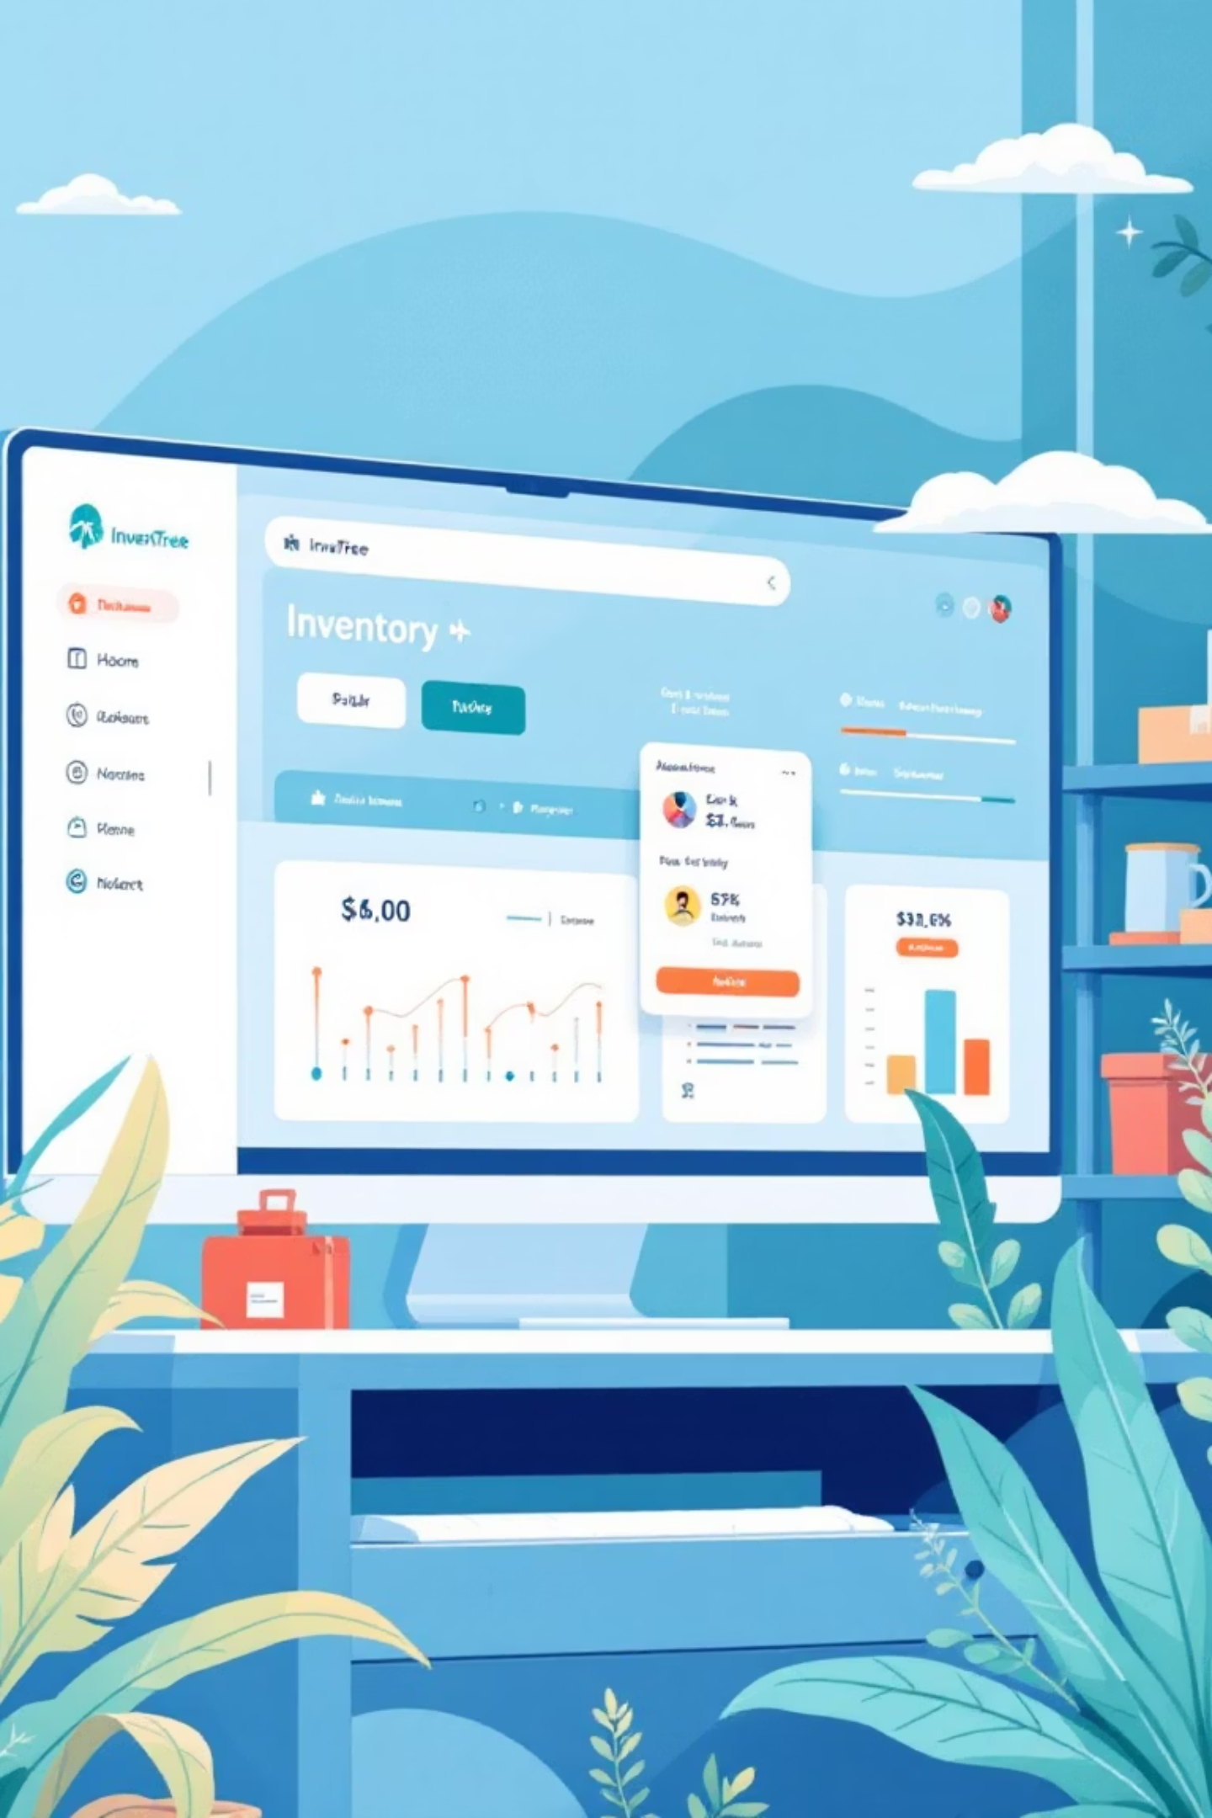


Open Source Example: InvenTree
Python/Django Foundation
Built on robust Python/Django framework with comprehensive REST API and intuitive admin interface for maximum flexibility and ease of use.
Plugin Ecosystem
Extensible plugin system enables custom extensions, third-party integrations, and business-specific modifications without touching core codebase.
Mobile Companion
Dedicated mobile application provides warehouse staff with powerful tools for stock control, barcode scanning, and real-time updates from anywhere.
Community-Driven
MIT licensed open-source project with active community contributions, regular updates, and transparent development roadmap for continuous improvement.
Group 13

Slide 9

Challenges & Best Practices
Data Consistency
Implementing proper locking mechanisms and transaction management ensures data integrity during concurrent inventory updates from multiple users and systems.
Business Logic Complexity
Managing intricate business rules including product lifecycles, supplier lead times, seasonal variations, and custom workflow requirements demands flexible architecture.
Security Implementation
Protecting APIs against unauthorized access requires robust authentication, authorization frameworks, data encryption, and comprehensive security auditing.
Future-Proof Design
Building extensible systems with modular architecture enables adaptation to evolving business needs without major system overhauls or disruptions.
Group 13

Slide 10

The Backbone of Efficient Inventory Management
Strategic Asset Transformation
Foundation for Success
Accelerated Development
Combining solid database design, scalable API architecture, and integration flexibility creates the foundation for sustainable business growth and market leadership.
Open source projects like InvenTree provide valuable blueprints, proven patterns, and development acceleration tools for rapid system implementation.
Well-designed backend systems transform inventory management from a cost center into a strategic business asset that drives competitive advantage and operational excellence.
Let's build smarter, faster, and more reliable inventory systems that power tomorrow's supply chains and drive unprecedented business success.
Group 13

